Slide 1


Slide 2

Introduction
Sports and fitness are very important for people with bleeding disorders. Safe exercises help strengthen muscles and joints, reduce weight, and lower the risk of pain and bleeding. A CDC study showed that being overweight can limit joint movement, no matter how severe the disorder is.
Low fitness also makes daily tasks harder. Staying active improves energy, mood, and overall health, helping the body avoid problems.
To support this, a website is being developed to share fitness information. It includes three types of users:
Admin: Manages users and adds payment/participation methods.
Trainers: Share exercises and answer questions.
Trainees: Register, explore topics, post content, and ask questions.
The goal is to promote fitness and reach a wide audience through an easy online platform.

Slide 3
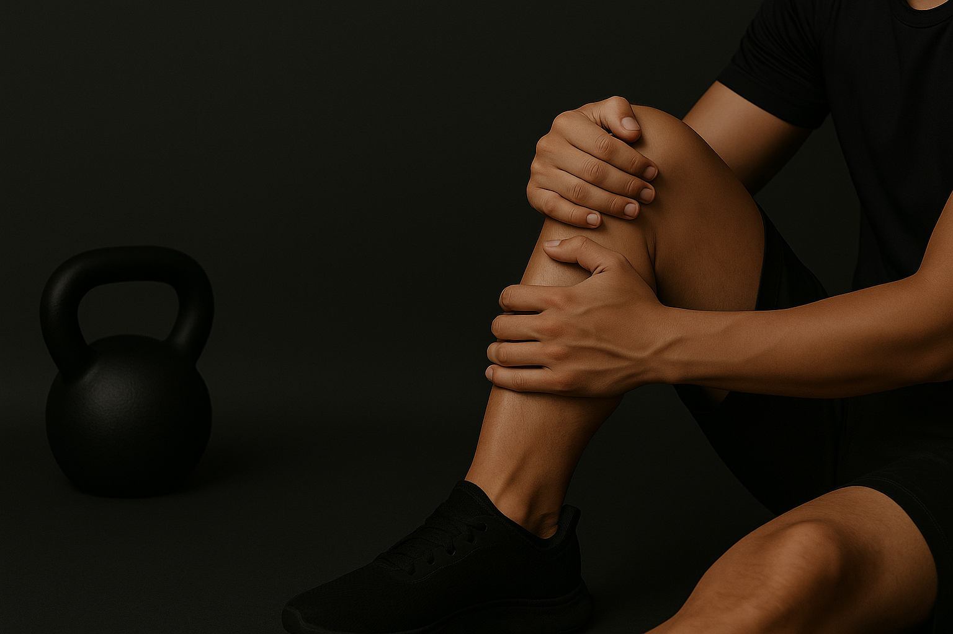
3
Problem
Parents see youth sports as a key part of their children’s growth and future success. Sports help build lifelong skills, giving parents confidence in their children’s development.
However, poor sports behavior and incorrect training remain serious issues. Many believe advanced exercises are more dangerous, but common bodyweight exercises can cause more harm if done incorrectly. Injuries often come from poor form and lack of proper guidance.
There is also limited awareness about the right nutrition to support physical training. Spreading correct information about exercise techniques and healthy diets is crucial.
Creating a system that shares reliable sports and nutrition knowledge will help people practice safely and consistently.
The Create Design And Concept That You Can Never Be Replicated

Slide 4





OBJECTIVE
Helping users in getting write information about sport exercise.
Help users get information about sports nutrition.
Spreading sports culture in society.
Providing educational and cultural content to members.
Providing tools and technologies to help visitors track their health and fitness.

Slide 5
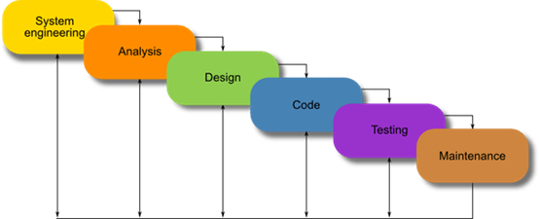
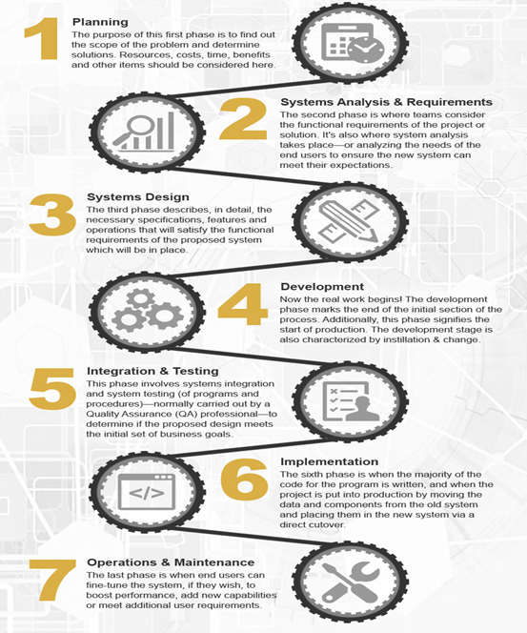
METHODOLOGY

Slide 6
Comparison | Proposed System | Physical Education Portal | Forum fitness elements | WebTeb
System idea and subjects | Specified with sport and fitness | General forum | General forum | Health with sport forum
Having discussion service about subject | YES having | Have not | Have not | Have not
Offering feedback service about subject | YES having | Have not | Have not | Yes Having
Adding subjects without checking it by Admin | Not available | Available | Available | Available
Registration in the forum is free | YES | YES | YES | YES

Slide 7
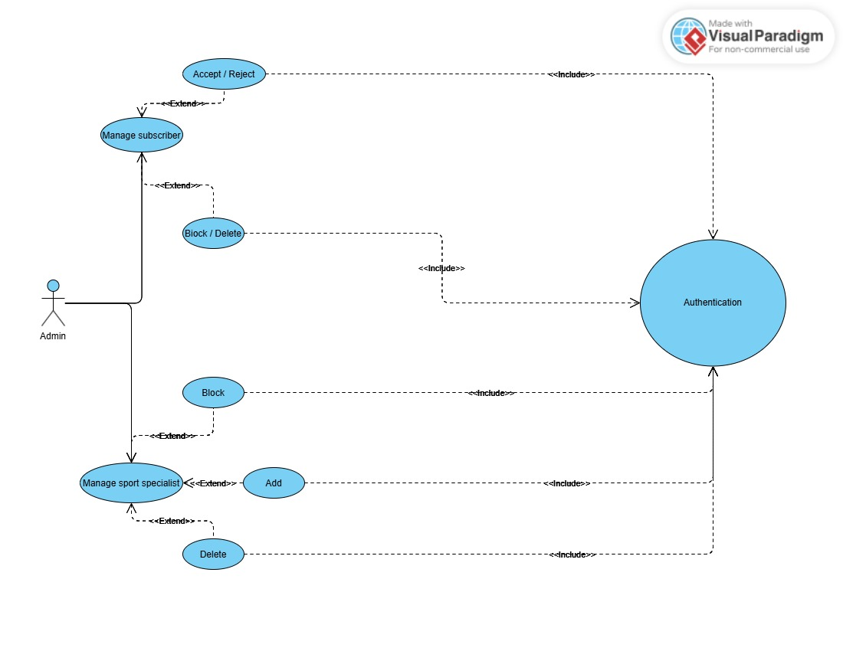
  ADMIN-USE CASE DIAGRAM

Slide 8
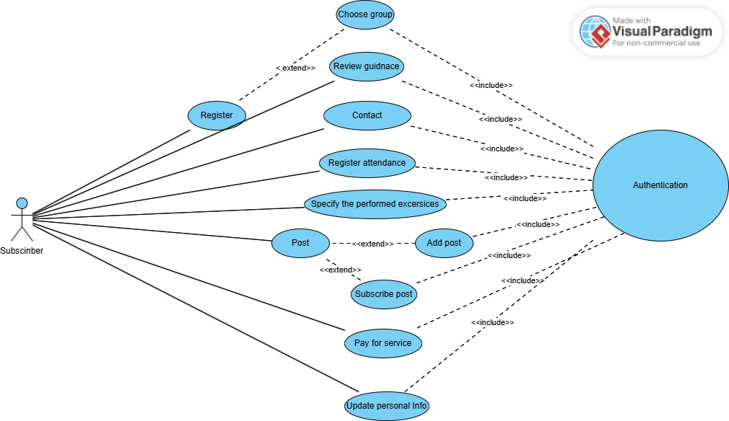
  Subscriber -USE CASE DIAGRAM

Slide 9
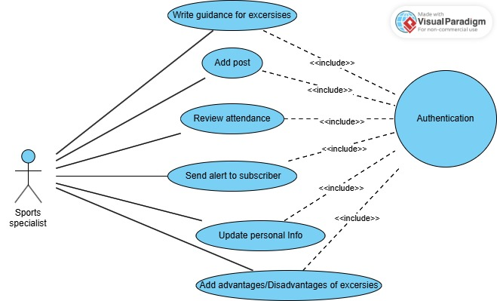
  Specialist-USE
  CASE DIAGRAM
Device Mockup

Slide 10
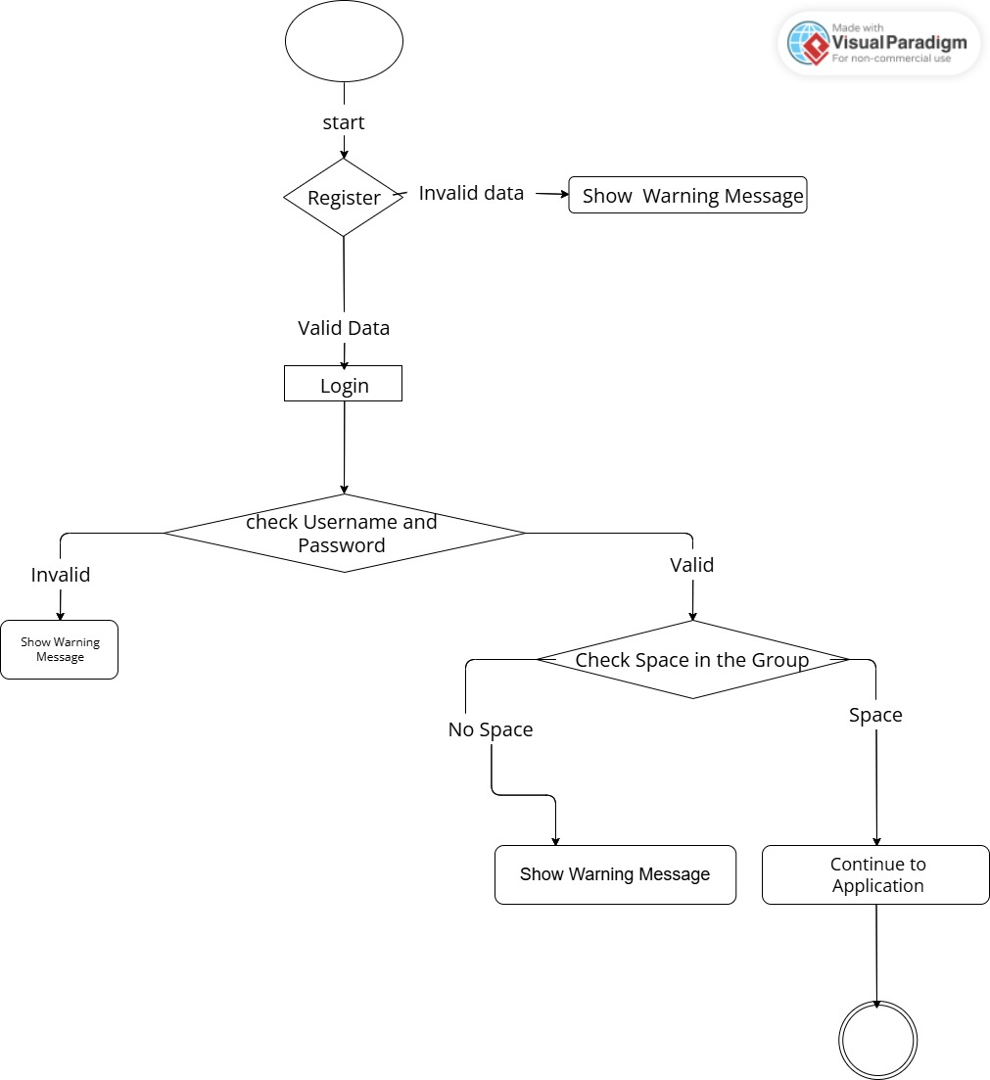
  Register and Authentication activity diagram
Bipolar Disorder

Slide 11
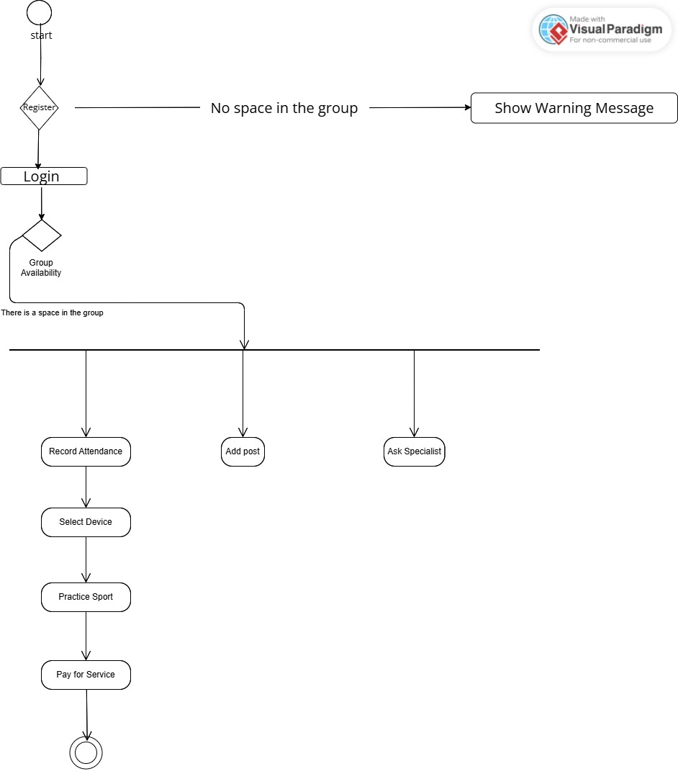
Subscriber activity diagram

Slide 12
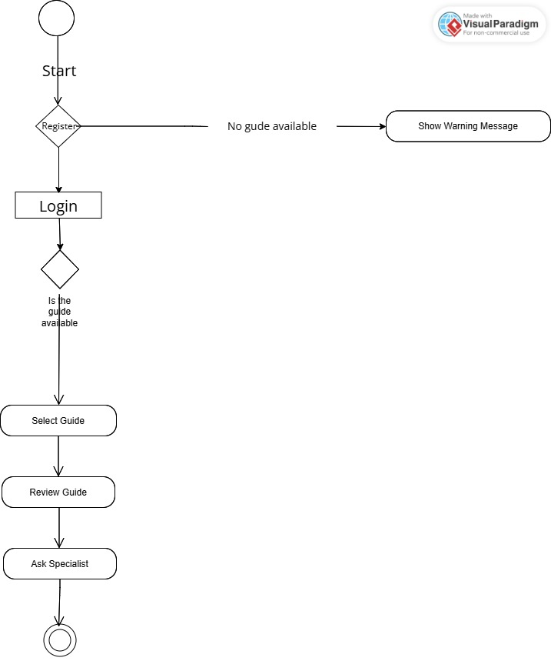
Specialist activity diagram

Slide 13
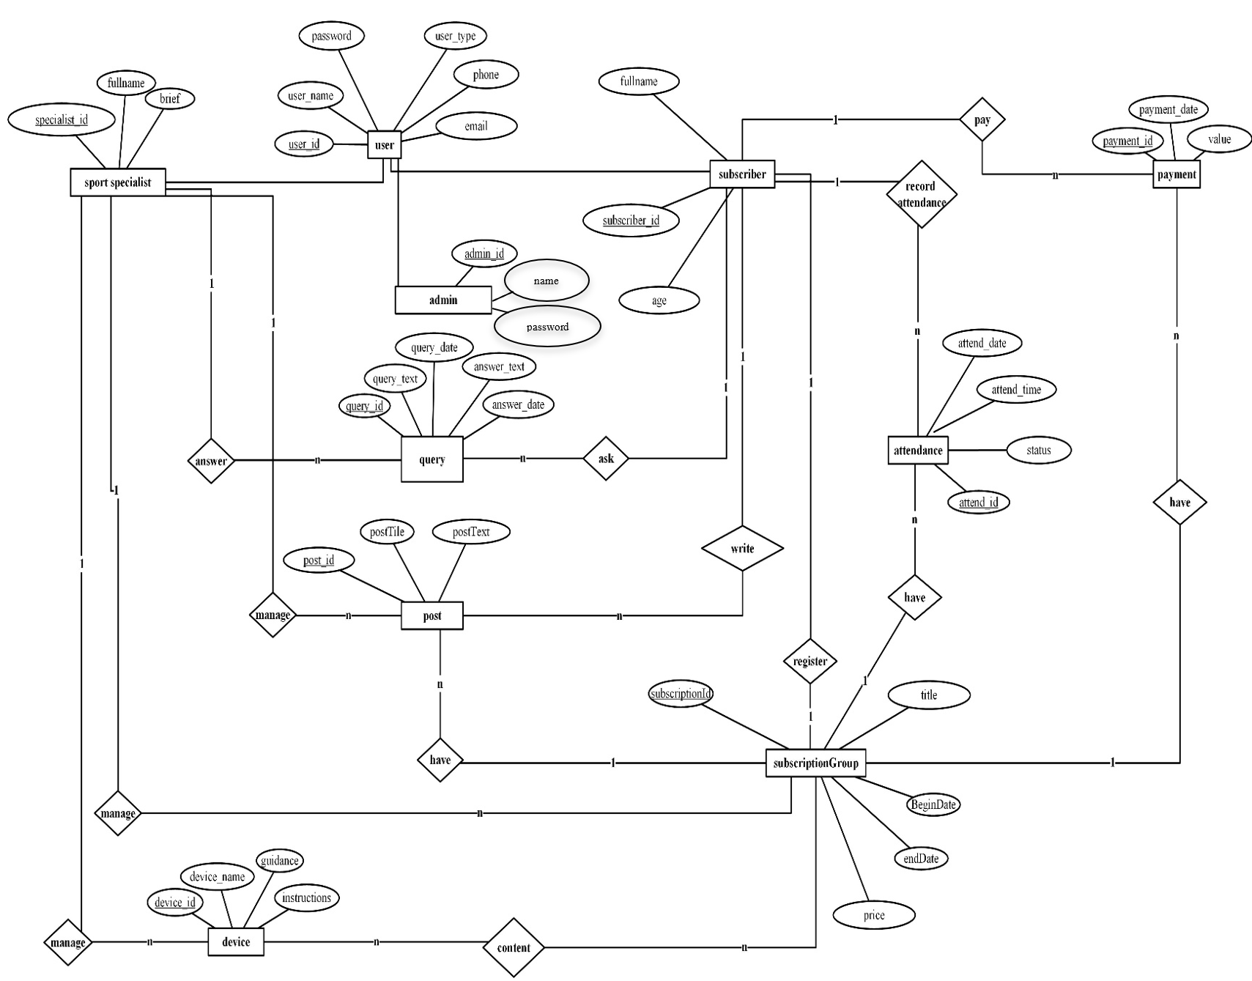
ERD Diagram

Slide 14
System requirements
NONFUNCTIONAL REQUIREMENTS | FUNCTIONAL REQUIREMENTS | Hardware Requirements | Software Requirements
Trust Performance Reliability Security | Login into the website using username and password. Manage subscriber user through the following functions. Manage specialist user through the following functions. Write guidance for device. Register the attendance. | Laptop: To develop the system (CPU: Intel Core i7, RAM: 8 GB, HDD: 1000 GB). Network and internet access provider: Help to search and gather information and execute the system online | Windows 10 AND 11 Word 2019 ASP.NET MS SQL SERVER GPT
Step 01

Slide 15
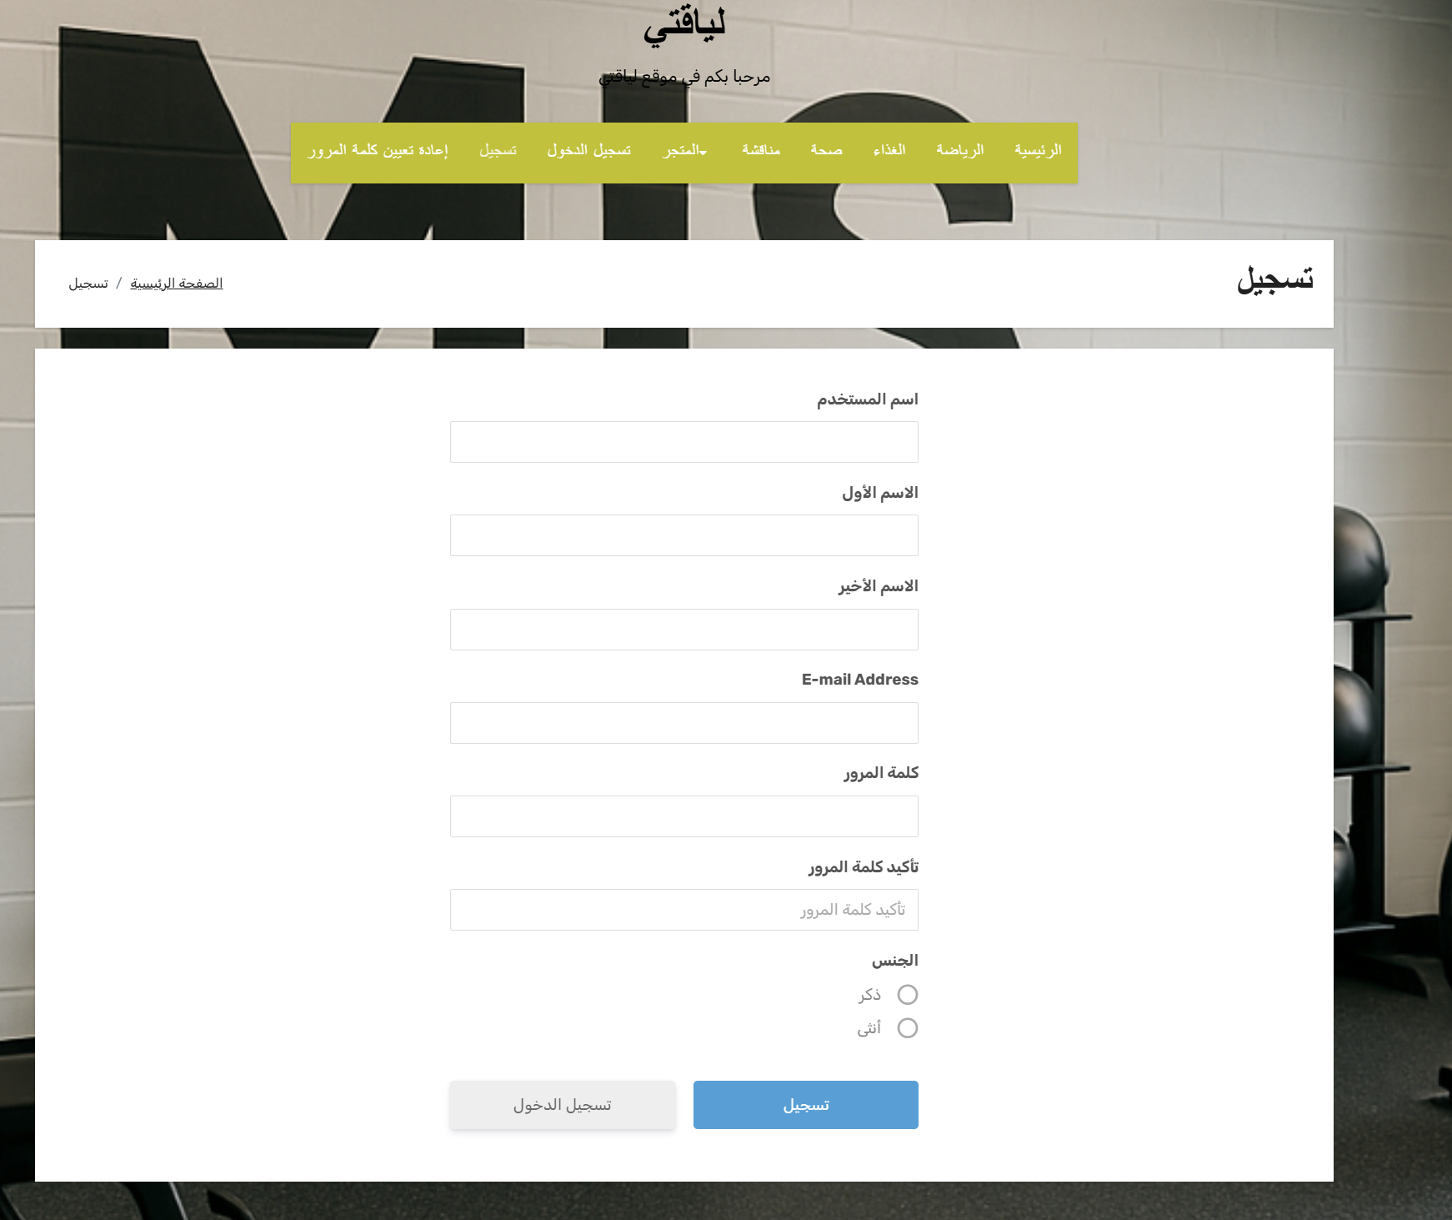
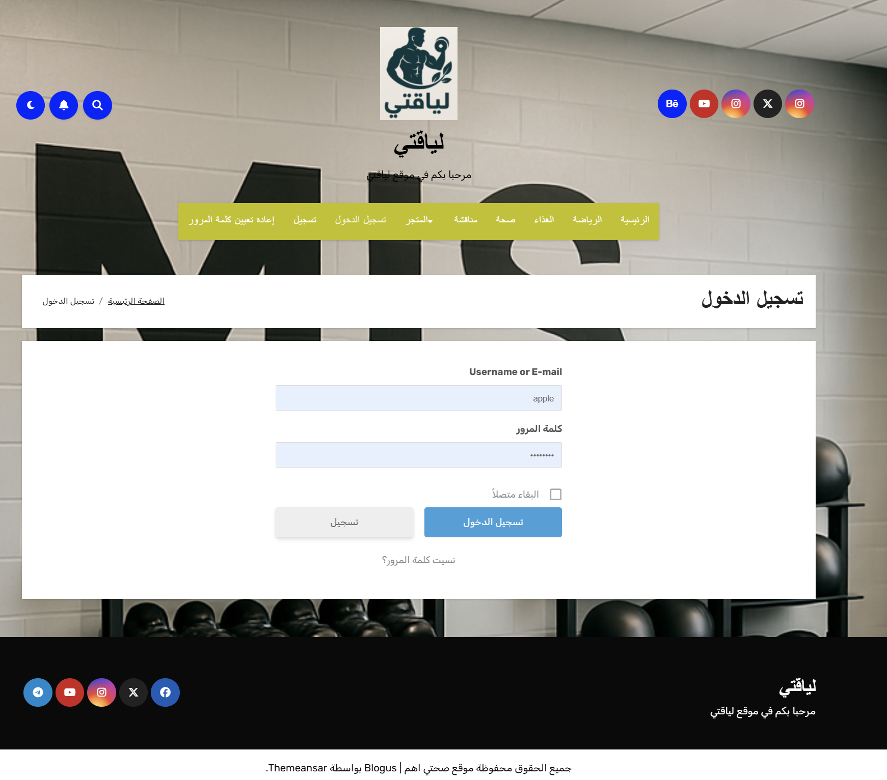
User interface implementation
1- Registration page
2-Login page

Slide 16
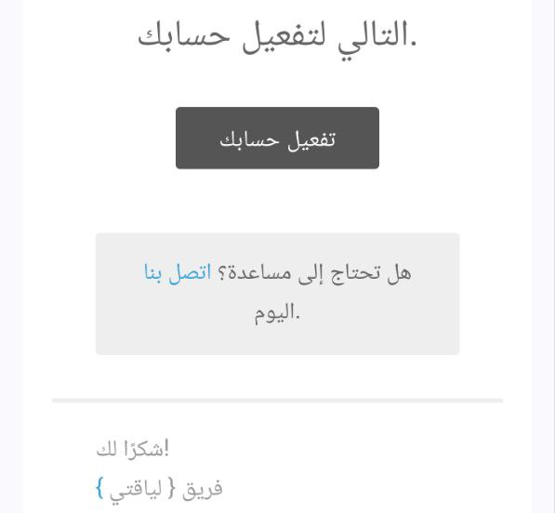

User interface implementation
3-Verification page
4 – Home Page

Slide 17
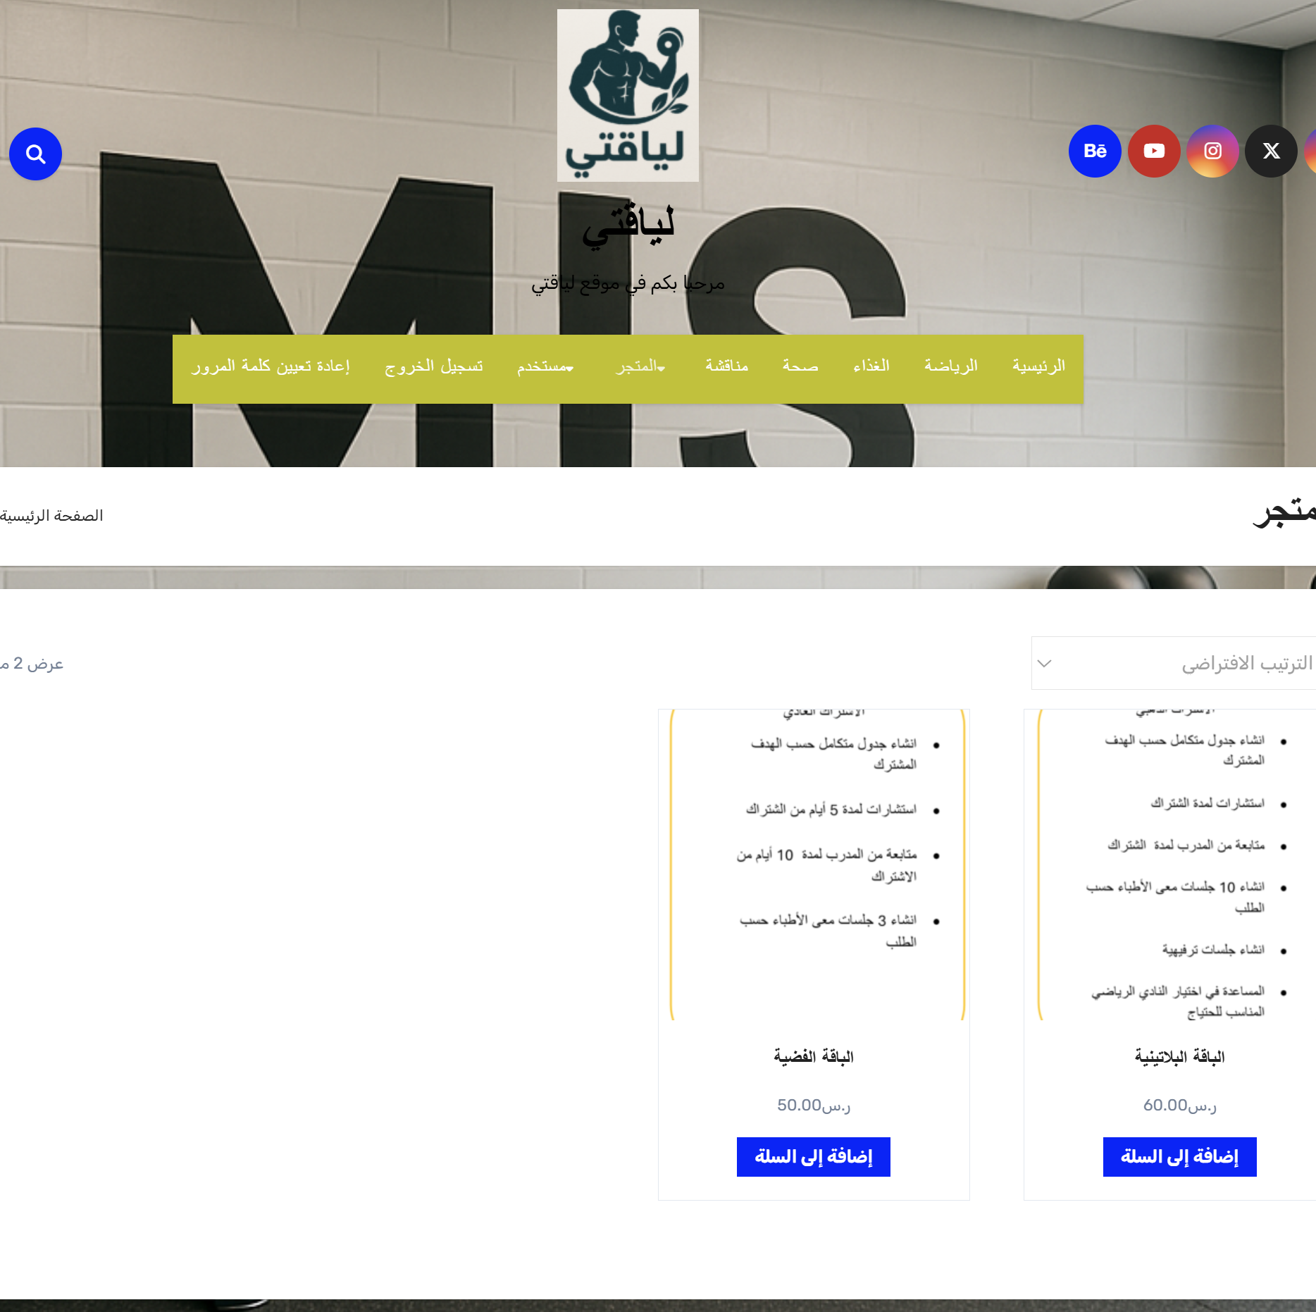
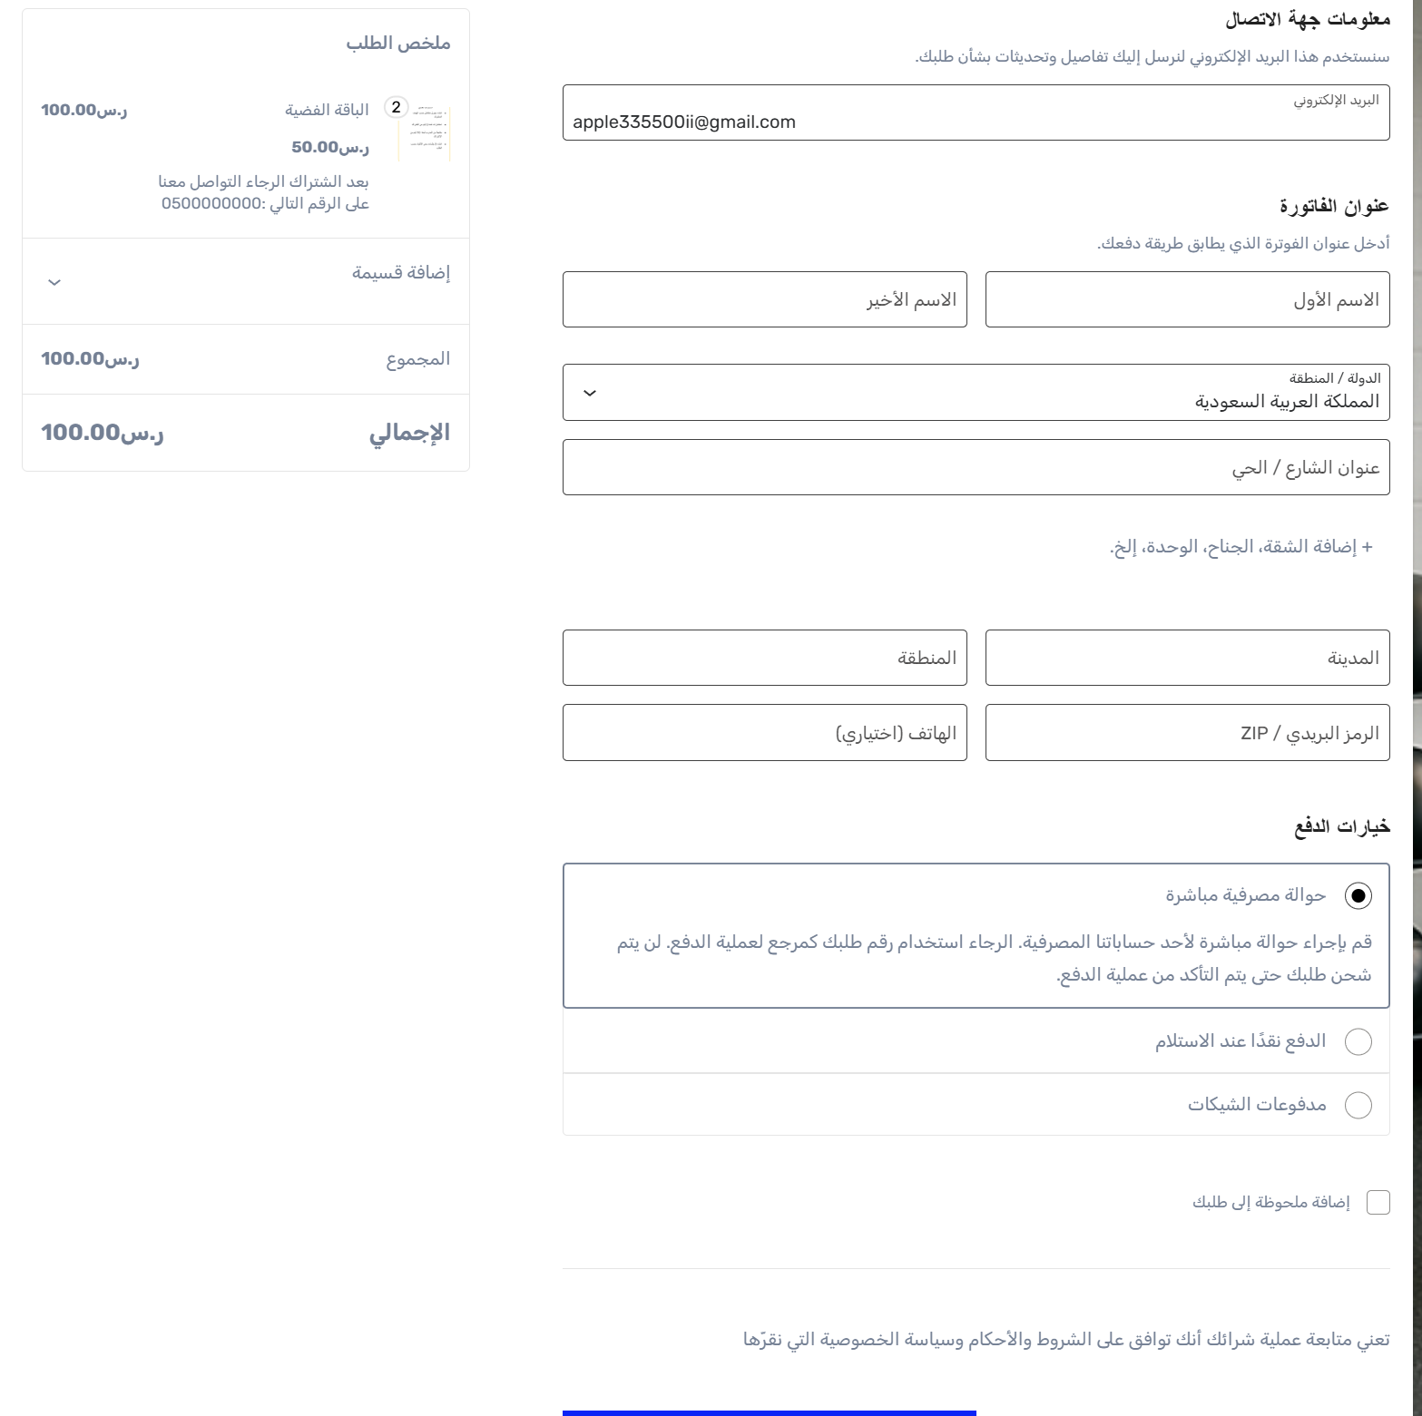
User interface implementation
5-Subscription page
6-Payment page

Slide 18
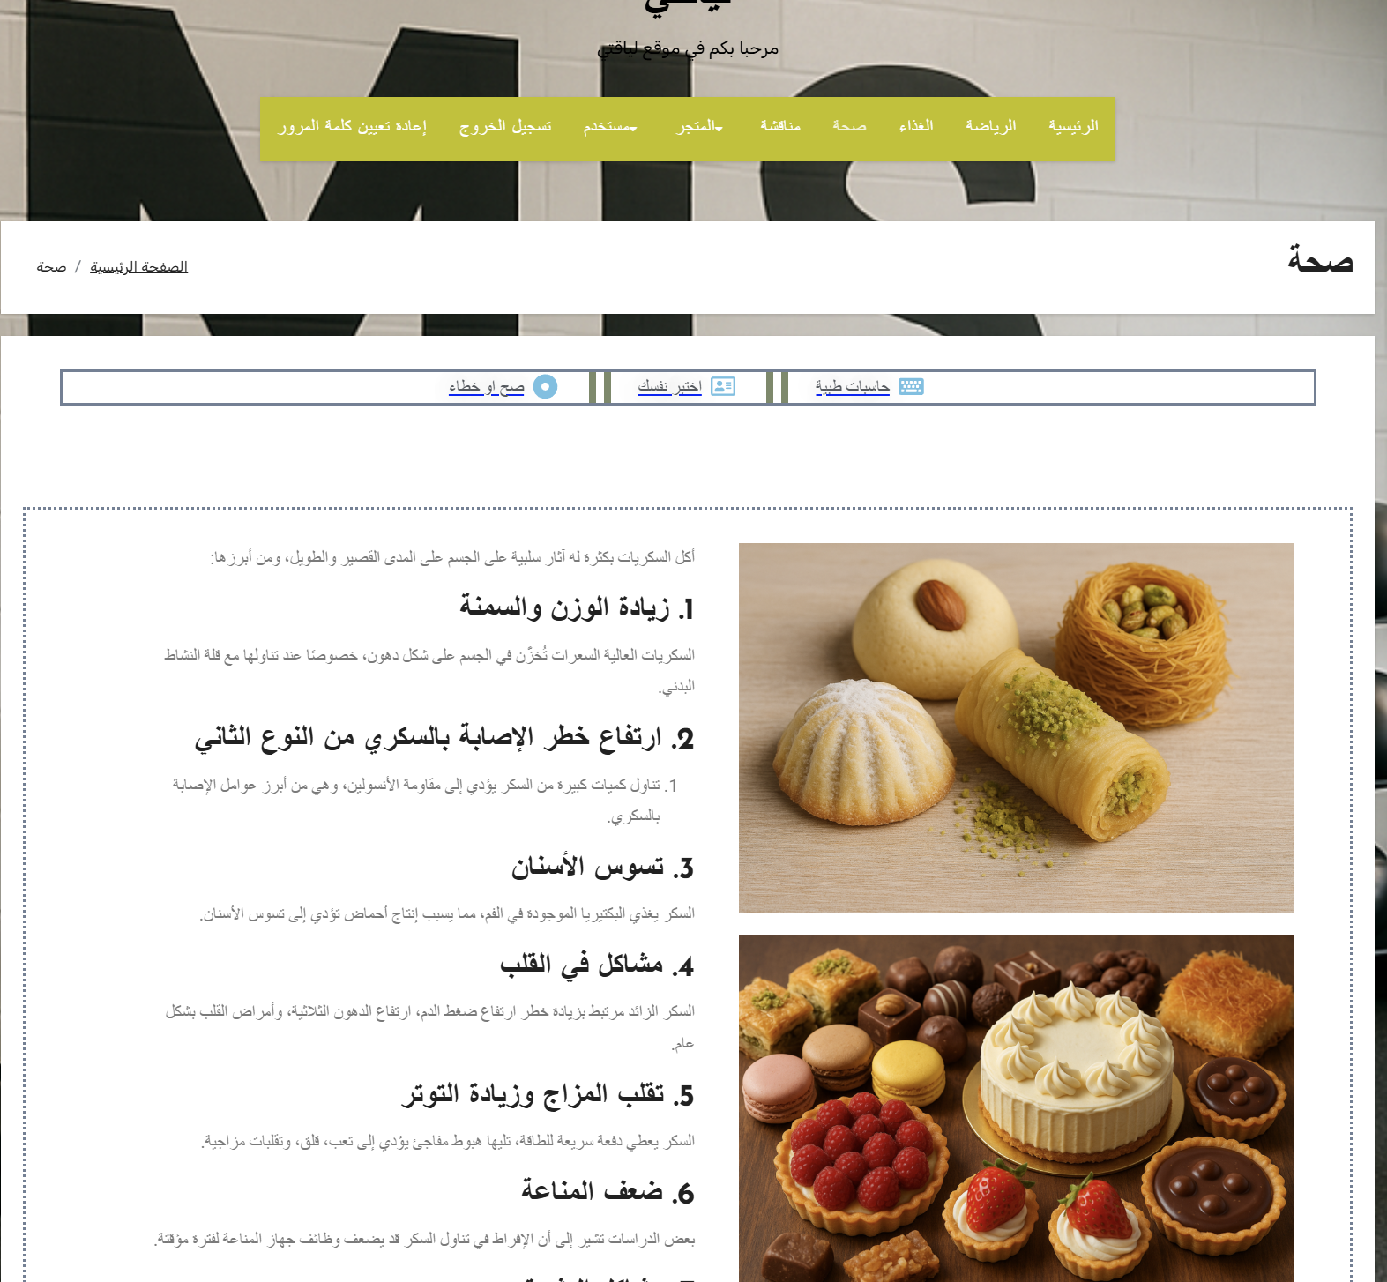
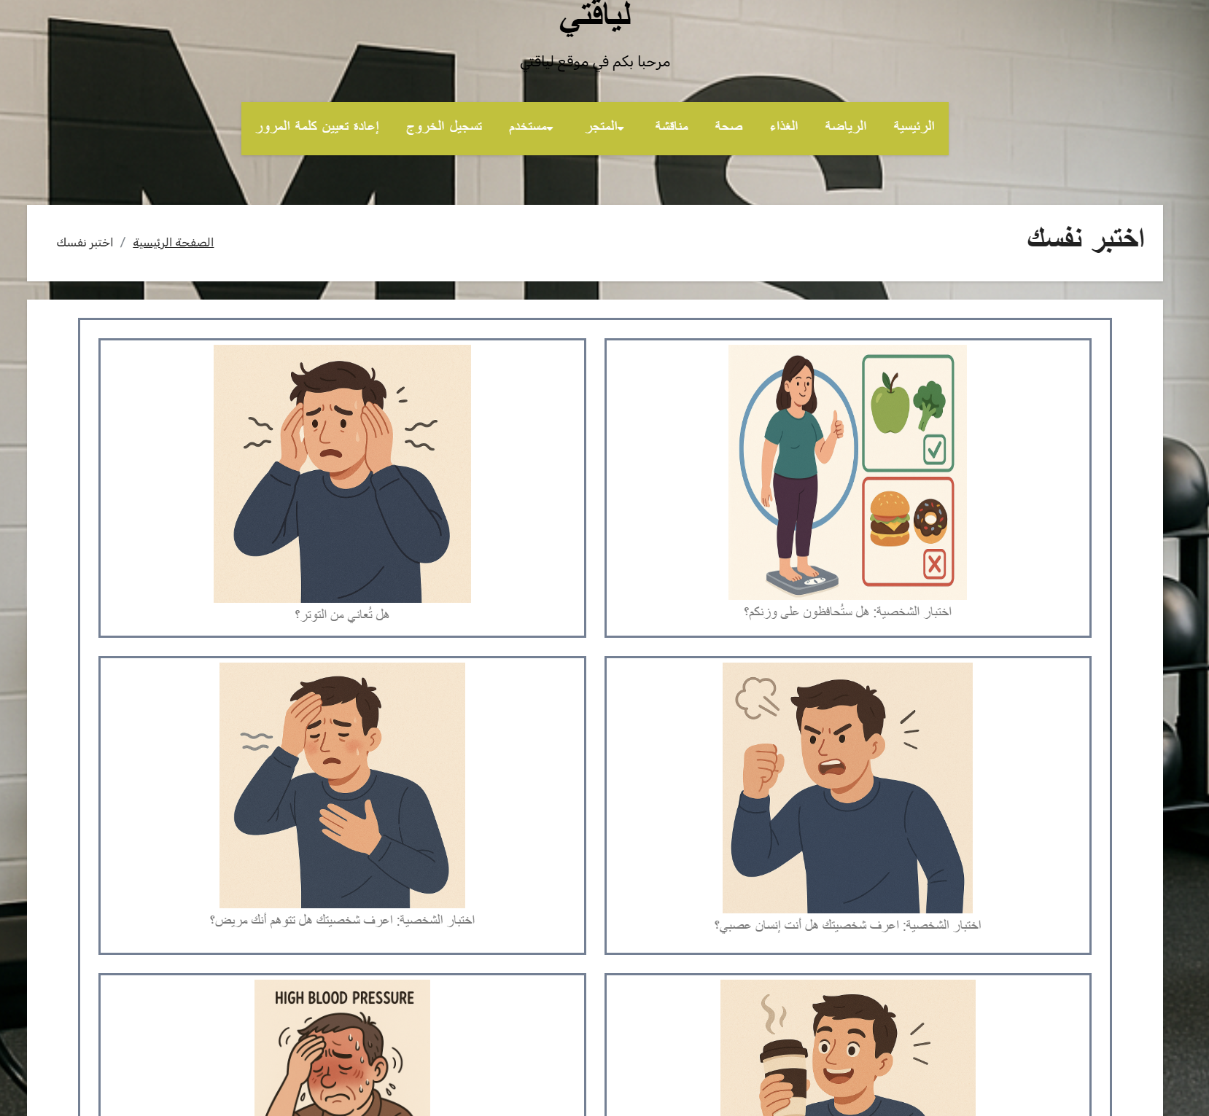
User interface implementation
7-Health page
8-Test page

Slide 19
Conclusion
We finished the study of our project through identify the project idea and objectives, also we specified the system requirements.
We finished the system analysis and design which explain the UML diagrams, database contents, and software interfaces of the system.

Slide 20
REFERENCES
[1] http://tarbiah.mam9.com/t705-topic
[2] http://www.al-batal.com/vb/forumdisplay.php?f=26
[3] https://www.webteb.com/articles/
[4] https://www.techopedia.com/definition/4371/system-requirements
[5] https://en.wikipedia.org/wiki/Unified_Modeling_Language
[6] https://www.smartdraw.com/use-case-diagram/
[7] https://www.geeksforgeeks.org/unified-modeling-language-uml-activity-diagrams/
[8] https://www.geeksforgeeks.org/unified-modeling-language-uml-sequence-diagrams/
[9] https://www.geeksforgeeks.org/unified-modeling-language-uml-class-diagrams/
[10] https://www.lucidchart.com/pages/er-diagrams

Slide 21


Thank You
For Your Important Times

