Slide 1
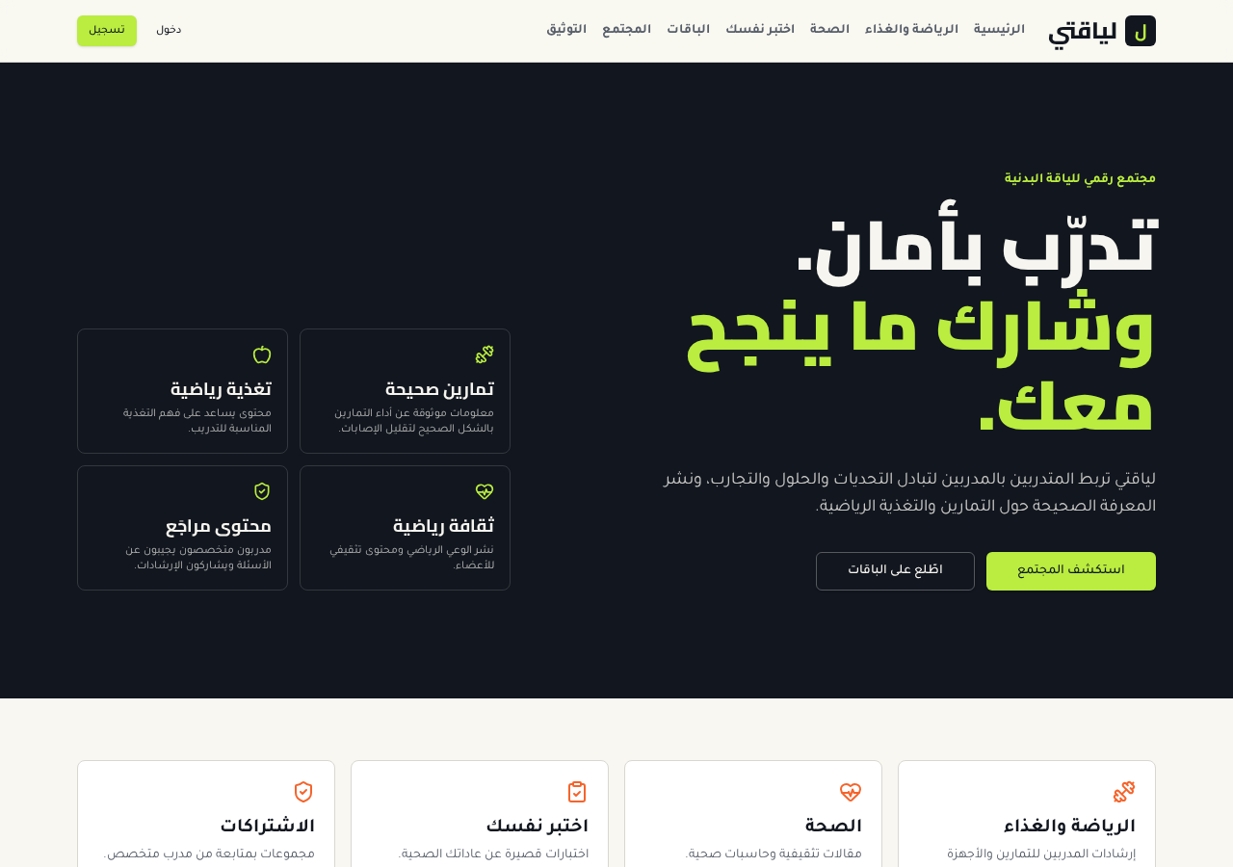
MIS ACADEMIC PROJECT
My Fitness
Digital Fitness Community Platform
Abdulaziz Al-Ali
King Khalid University – MIS Program

Slide 2
WHAT & WHY
Project Overview
1
2
3
The problem
The solution
Purpose
Fitness information online is scattered and often unreviewed, with no single place for guidance, supervised groups and community.
An Arabic (RTL) web platform linking trainees with specialist trainers, overseen by an administrator.
Learn, share challenges and experiences, join supervised groups and ask trainers — with reviewed content.
02
Notes:
Educational prototype — not medical or professional training advice.

Slide 3
FROM THE PROJECT ANALYSIS
Project Objectives
Exercise information
Sports nutrition
Spread sports culture
Reviewed trainer guidance on exercises and equipment
Nutrition guidance category
Community posts: challenges, solutions, experiences, tips
Tracking tools
Organized workflows
Educational content
BMI & water calculator, self-tests, attendance log
Groups, subscription requests, admin approval
Health article and cultural guidance
03

Slide 4
THREE ACTORS, ONE PLATFORM
Requirements Analysis
1
2
3
Subscriber
Specialist (Trainer)
Admin
Register & verify email
Subscribe to a group
Record attendance
Ask questions, publish posts
Write exercise, device & nutrition guidance
Answer questions
Review attendance, send alerts
Manage users & trainer role
Groups, capacity, payment methods
Approve requests & content
Non-functional: Arabic RTL · responsive · database-level access control · rules enforced even if the UI is bypassed
04

Slide 5
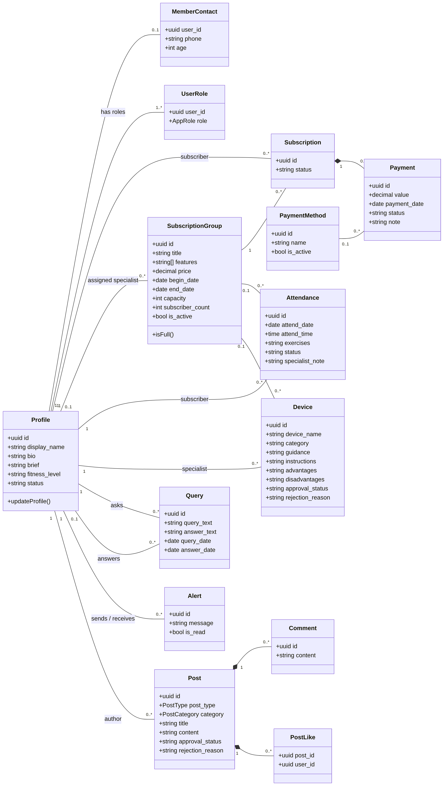
MY ACADEMIC CONTRIBUTION
System Analysis & Design
Requirements Analysis
Actors, use cases, 8 interfaces: Registration, Login, Verification, Home, Subscription, Payment, Health, Test
OOAD
Domain classes, associations, activity & state models (e.g. 'check space in group')
Database Design
Normalised entities with keys, constraints and role-based access; roles in a separate table
Class diagram
05

Slide 6
SUBSCRIBER JOURNEY
User Workflow: Group Registration
1
2
3
4
5
›
›
›
›
Browse packages
Check space in group
Choose payment method
Request pending
Admin accepts / rejects
Group full
Safeguards
Registration is blocked and the “No space in the group” warning is shown.
One registration per group; seat count updates on accept/reject — enforced in the database.
06

Slide 7
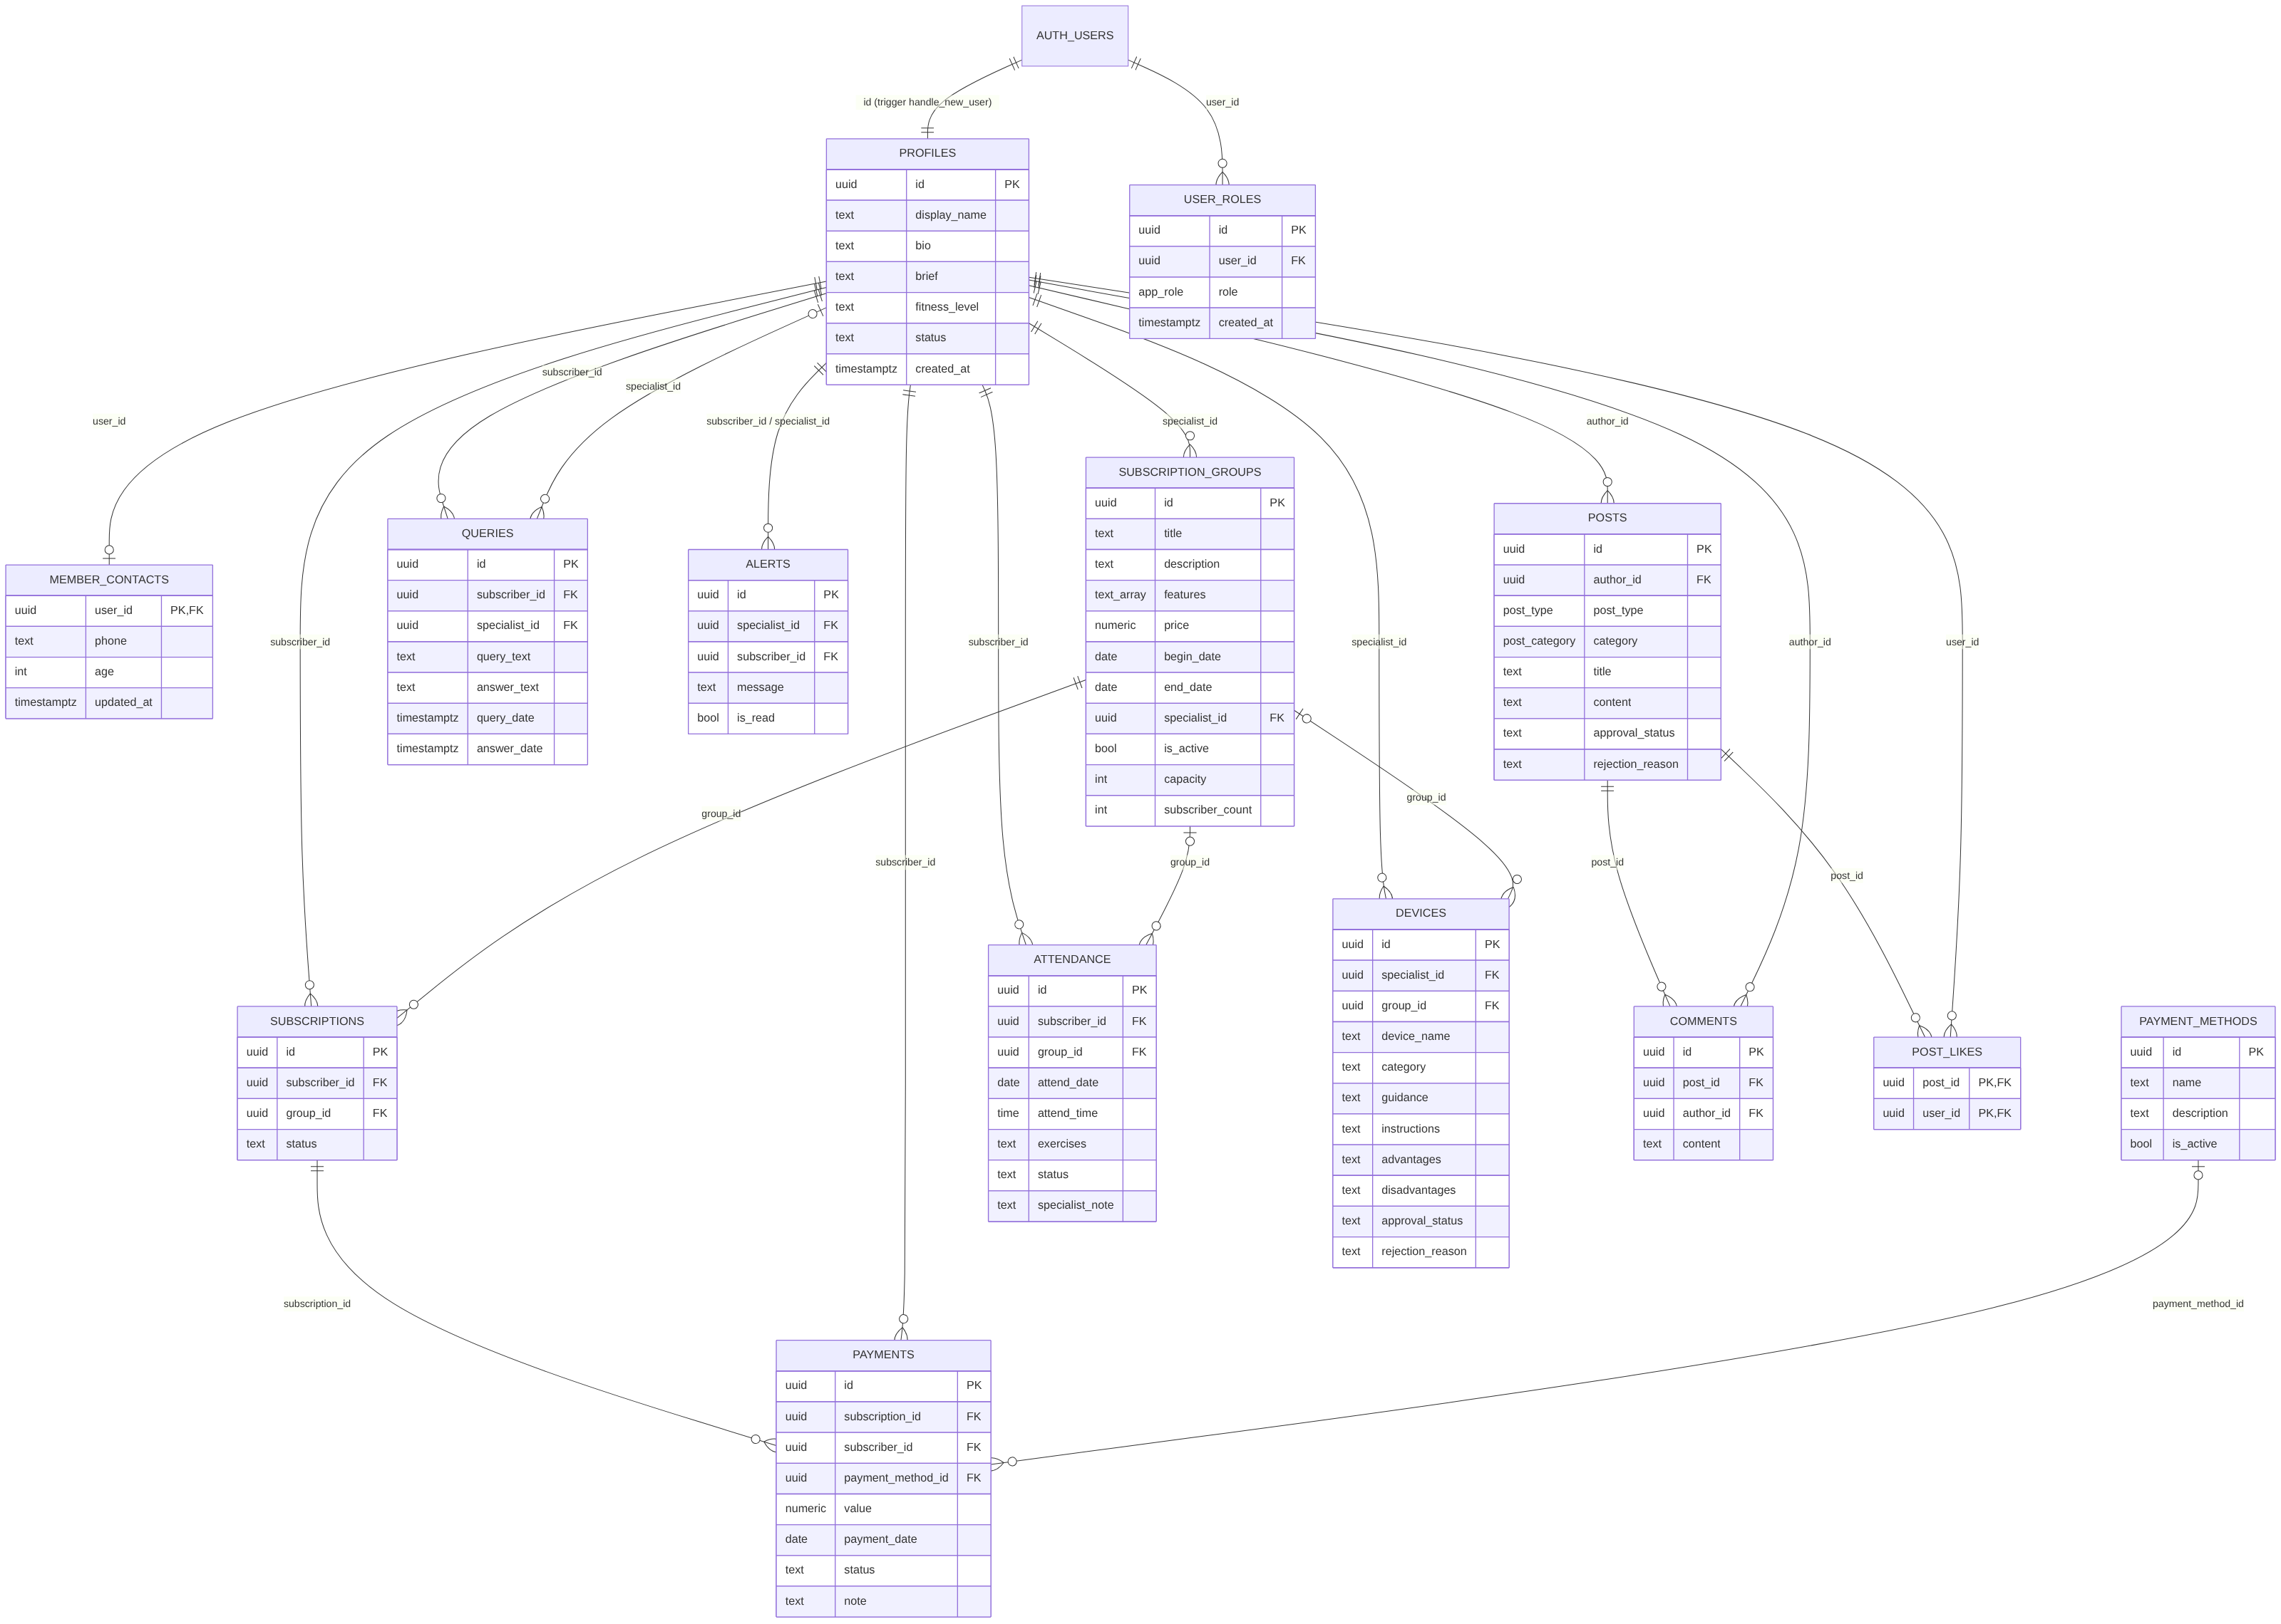
ENTITY-RELATIONSHIP DIAGRAM
System Design & Database
Key facts
14 related tables
Roles via user_roles + has_role()
Triggers: capacity, attendance validity, content approval
Row-level security on every table
07

Slide 8
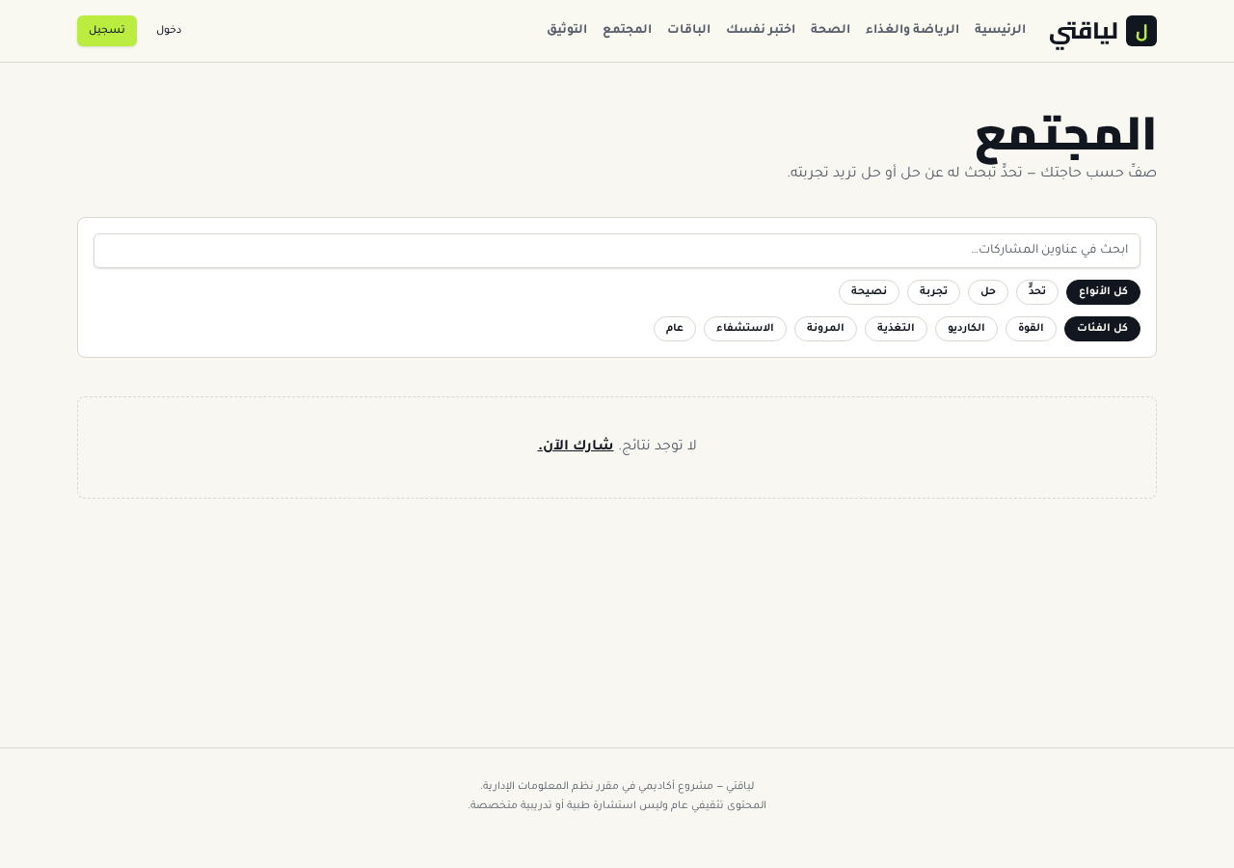
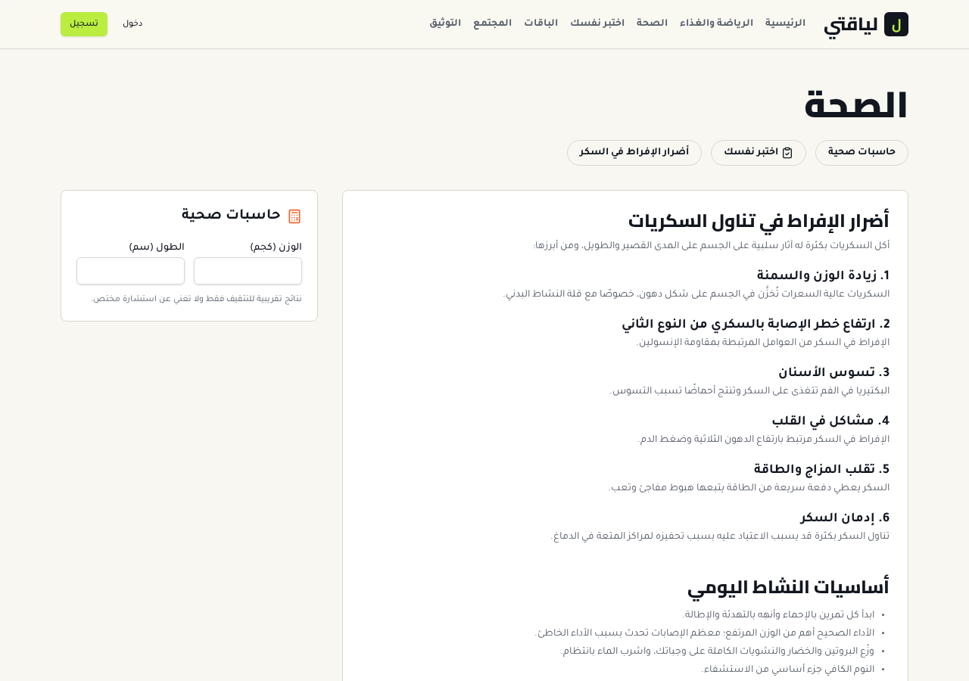
ACADEMIC PROJECT → INDEPENDENT REDEVELOPMENT
Web Application
Academic project: analysis & design. Redevelopment: a working Arabic web app built afterwards with an AI-assisted platform (React, TanStack Start, Lovable Cloud).
Home
Community
Health tools
08
Notes:
The app code was produced with an AI-assisted development platform based on my analysis and design.

Slide 9
ROLE CLARITY
My Contributions
01
02
03
04
Requirements Analysis
OOAD
Database Design
System Development & Implementation
Academic project
Academic project
Academic project
Independent redevelopment, AI-assisted
09

Slide 10
OUTCOMES
Conclusion
Achieved
Learned
Demonstrates
All eight documented interfaces and three role workflows, with rules protected at database level.
Turning requirements into models, schemas and access rules; honest scoping of a prototype.
MIS thinking: systems analysis, business process design and technology delivery.
10

Slide 11
Thank you
Abdulaziz Al-Ali
abdulaziz-alali.com

