Slide 1
Redesigning Gasoline Supply Process
A Business Process Reengineering (BPR) Initiative for Fuel Retail Operations
Course :
Business Process Reengineering
Project Supervisor:
Dr. Khalid Mohiuddin
Co-Developed By:
Abdulaziz AL-Ali
Hassan Hadrah

Slide 2

Phase 1 & Step 1
Project Strategic Scope, Case for Action, and Vision Statement

Slide 3
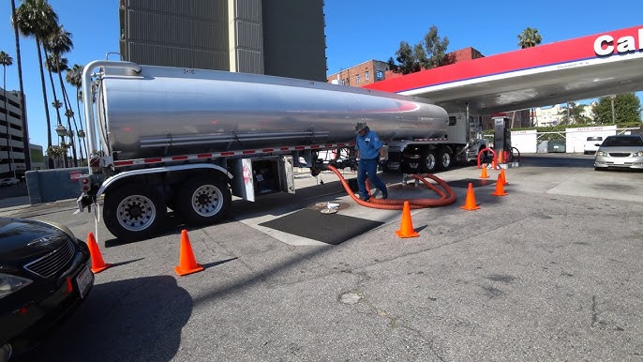
Step 1: Case for Action
Urgency for Process Redesign
As a leading supplier of gasoline, our core operation relies on transporting fuel from central storage terminals directly to retail gas stations. However, current operations face critical operational bottlenecks:
•
Legacy Fleet Limitations: Operating only 12 outdated delivery trucks lacking basic telematics and GPS tracking.
•
High Logistics Costs: Excessive fuel consumption and frequent breakdowns inflate transit overheads.
•
Customer Dissatisfaction: Chronic delays in fuel station replenishment leading to stockouts and consumer complaints.

Slide 4







Step 1: Strategic Vision Statement
1. Workforce Training
2. Fleet Renewal
3. Smart Dispatching
4. Fleet Communication
Phased replacement of old trucks with modern, high-capacity, fuel-efficient fuel tankers integrated with smart monitoring systems.
Upskill truck drivers in advanced defensive driving, time management, and rapid on-road troubleshooting to ensure schedule compliance.
Implement dynamic route mapping for each truck to prevent traffic delays, lower transit time, and improve fleet responsiveness.
Equip every vehicle with dedicated two-way telematics and live support radios for instant hazard reporting and roadside help.

Slide 5


Step 2: Process Identification (Pm)
Supply Chain Workflows (P1 - P3)
Station Delivery & Return (P4 - P5)
P1. Loading Fuel: Pumping fuel into trucks at primary depot storage tanks.
P4. Station Unloading (Troubled): Pre-arrival notification to clear vehicles (P4.1) and emergency safety signs installation (P4.2).
P2. Security & Verification: Barcode identification and work card checks (P2.1, P2.2) to mitigate fuel theft risks.
P5. HQ Return: Conducting post-trip safety checks (P5.1), delivery documentation audit (P5.2), and preparing for next trip (P5.3).
P3. Road Transportation (Troubled): Overcoming municipal traffic windows (P3.1), road potholes/diversions (P3.3), and traffic delays (P3.4).

Slide 6
Step 2: Process Activity Chart
# | Activity Description | Time (Min) | Symbol | Value Code
1 | Schedule route dispatch for each truck | 30 |  | Operation (Value Add)
2 | Truck safety inspection & tank wash | 16 |  | Inspection (Necessary)
3 | Fuel tank loading at supply depot | 20 |  | Operation (Value Add)
4 | Driver identity check & gate clearance | 8 |  | Control (Security)
5 | Road transit to station & unloading | 28 |  | Transport / Operations
6 | Return to HQ & trip documentation | 30 |  | Operation / Log

Slide 7

Step 3: Management Commitment & Budget
Business Pitch & Budget Allocation
235K
To prevent operational failure and win executive approval, the proposed redesign establishes a structured capital allocation plan:
•
Fleet Modernization: SAR 100,000 for acquiring high-efficiency delivery trucks.
Total Estimated Investment (SAR)
•
Advanced Safety Equipment: SAR 10,000 for fire safety gear and emergency tools.
•
Emergency Support Truck: SAR 20,000 for quick-deploy breakdown response unit.
•
Digital Infrastructure & Software: SAR 105,000 for dispatch, filtration, and IoT sensors.

Slide 8

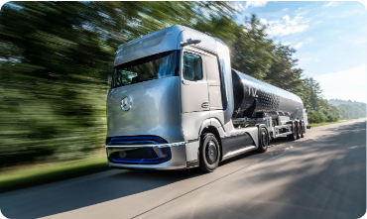

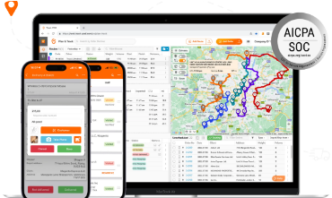
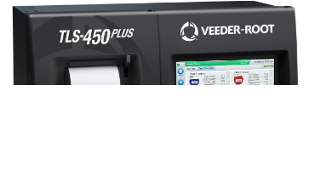
Step 4: Design & Technological Enablers
1. Telematics & Sensors
2. Smart Scheduling
3. Predictive Station IoT
Smart trucks equipped with automatic fire alarms, safety sensors, and roadside communication devices.
Intelligent routing software to schedule transit during non-peak hours, cutting city traffic bottlenecks.
Real-time gas station tank sensors & inline fuel filtration devices to maintain fuel purity during discharge.

Slide 9
Step 5: Acquiring Process Understanding
Key Stakeholder Mapping: Engaging fuel suppliers, logistics dispatchers, station operators, and transport authorities to map end-to-end responsibilities.
Documentation Gathering: Reviewing existing delivery schedules, SLAs, supply agreements, and safety regulatory compliance benchmarks.
Stakeholder Field Interviews: Conducting structured interviews with truck drivers and station managers to pinpoint transit friction points and inventory delay causes.
Customer Segmentation Analysis: Segmenting end-users into retail motorists, commercial fleets, and industrial buyers to align supply schedules with peak demand patterns.

Slide 10
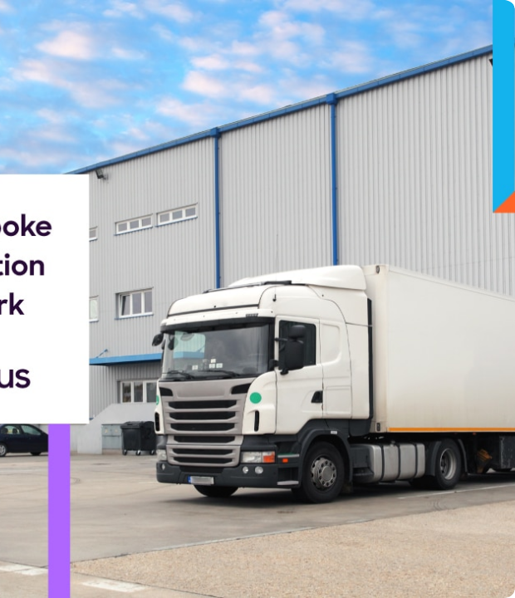
Step 6: Creative Process Design
To-Be Solution Architecture
1. Standard Operating Instructions (SOP): Established contingency protocols for driver emergency response.
2. Route Optimization: Automated dynamic navigation to steer trucks clear of high-density traffic zones.
3. Pre-Arrival Automated Alerts: Transmit live signals to station teams 15 mins prior to arrival for site clearance.
4. Rapid Support Dispatch: Mobile maintenance units ready for immediate roadside assistance.

Slide 11
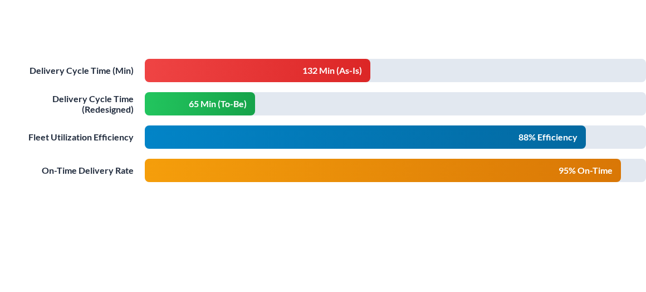
Step 7 & 8: BPR Impact & Simulation

Slide 12
Questions & Answers
Thank you for reviewing our Business Process Modeling Project.

