Slide 1
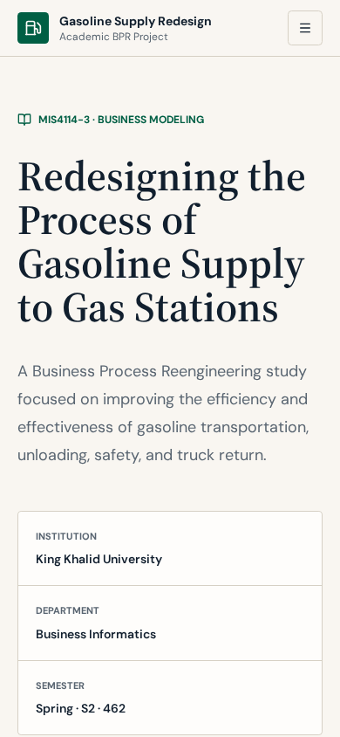
BUSINESS PROCESS REENGINEERING (BPR)
Gasoline Supply Chain Redesign
King Khalid University – MIS Program
MIS4114-3 Business Modeling · 2024–2025
Abdulaziz Al-Ali
01
Notes:
Academic BPR project on redesigning gasoline delivery from headquarters to gas stations, later visualized in an independently built web application.

Slide 2
PROJECT OVERVIEW
Why redesign gasoline delivery?
Business problem
The process
Transporting gasoline to stations became expensive and difficult, and customers reported fuel not arriving on time.
Trucks are scheduled, prepared, filled and verified at headquarters, travel to stations, unload, and return.
Why BPR
Vision
Problems concentrate in two stages: P3 travel to the station and P4 unloading fuel safely.
“To become the best supplier of gasoline in the region, we must first improve efficiency and then develop the transportation process.”
02

Slide 3
CURRENT PROCESS
Current process: five stages
P1
P2
P3 · TROUBLE
P4 · TROUBLE
P5
Determine truck routes
Inspect and prepare
Travel to the station
Unload fuel safely
Return and prepare
Schedule and route per truck
Clean truck, check fuel, fill, verify identity/permission
Traffic, congestion, road conditions
Clear customers, safety procedures, fill tanks
Safety check, document, next trip
Decision points in P2: Is the truck clean? Is fuel available? (wait if not)
03

Slide 4
PROBLEM ANALYSIS
Documented problems
Delivery delays
Road conditions
Congestion & waiting
Fuel does not arrive on time (P3)
Potholes and diversions (P3)
City entry/exit times, long waits (P3–P4)
Breakdowns
Unloading safety
Fire risk & cost
Older, limited trucks; hard to communicate on the road (P3)
Customers must be cleared from the area (P4)
Safety tools need renewal; transport became expensive
04

Slide 5
BUSINESS PROCESS REENGINEERING
How BPR was applied
Current
Analysis
Redesigned
Older trucks, breakdowns, congestion, unloading risk
6 BPR steps: case for action → selection (P3, P4) → commitment → enablers → understanding → design
People, vehicle, support, scheduling and safety enablers
Management commitment requested: newer trucks, new safety equipment and a backup truck (documented costs: trucks 100,000 · equipment 10,000 · other 5,000 · ad. 20,000).
05

Slide 6
PROPOSED MODEL
Redesigned process
P1 +
P2 +
P3 +
P4 +
P5
Determine routes
Inspect and prepare
Travel
Unload safely
Return and prepare
Truck-specific plans; city entry/exit scheduling
Newer, larger, fuel-efficient trucks with fire alarms
Communication device, backup truck, spare parts, rapid support teams
New fire-safety tools, station prediction devices
Unchanged
06

Slide 7
PROPOSED IMPROVEMENTS
Supply chain & operational improvement
Supply chain flow
Process analysis
Scheduling city entry/exit and station prediction devices to reduce congestion and long waits.
Trouble stages located (P3, P4); nine activities timed in the activity chart.
Operational improvement
Strategic planning
Backup truck, spare parts at HQ, rapid support teams, driver time commitment and problem-solving.
Replace older trucks; approval for trucks, safety equipment and a backup truck.
07
Notes:
All improvements are qualitative proposals from the academic project; no measured results are claimed.

Slide 8
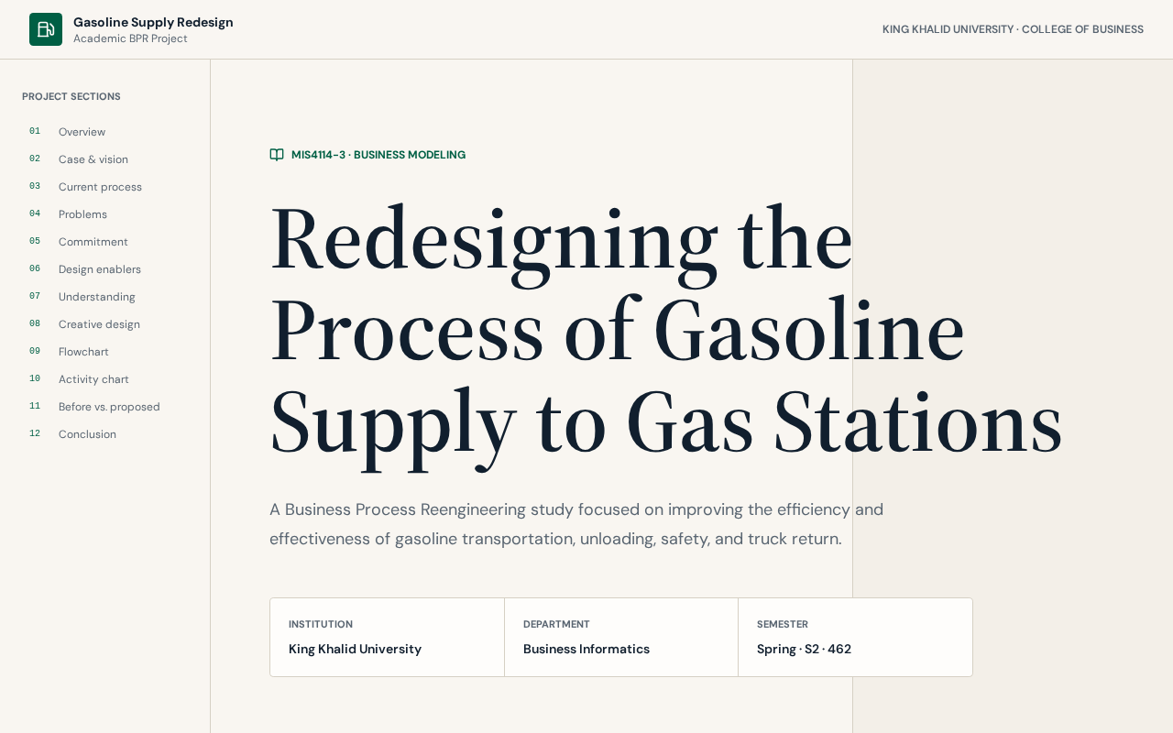
AFTER THE ACADEMIC PROJECT
Independent web application
Academic BPR project → Independent web development
Visualizes the current and redesigned process
Interactive flowchart and activity chart
Before vs. proposed comparison
Static, responsive presentation site
fuel-flow-revamped.lovable.app
08

Slide 9
ROLE
My contributions
Academic BPR project
Independent development
Business Process Reengineering
Process analysis
Supply chain optimization proposals
Strategic planning
Designed and built the web application
Implemented process visualizations
Kept all content faithful to the project
09
Notes:
This was an academic project followed by independent redevelopment, not professional logistics experience.

Slide 10
SUMMARY
Conclusion
Problem
Redesign
Skills shown
Costly, late, risky gasoline delivery at P3 and P4
Five stages enhanced with people, vehicle, support and safety enablers
MIS, business analysis, process improvement, supply chain thinking, web development
“If these solutions are activated, the company's position will be improved for the better.”
Abdulaziz Al-Ali
https://abdulaziz-alali.com
10

